Slide 1

Intro To Python
Luca Coviello
WebValley 2023
@lucoviello
/in/luca-coviello

Slide 2
today
Python, but particularly, why Python?
installing and first steps
variables, data structures and constructs
functions and object-oriented programming
time to practice even more!
Practice!
Practice!
&
Practice!
Solutions and examples can be found @ https://github.com/covix/intro-to-python/
(but do not check them out yet)
content from https://github.com/ehmatthes/intro_programming
Special thanks: Valerio Maggio (@lerioma) and Lorenzo Gaifas (@brisvag)

Slide 3
Python Programming Language
High-level Programming Language
Very shallow learning curve
Multi Platform
Windows, Linux, Unix (macOS)
Off-side-rule based
i.e., no brackets nor semicolon required
Language of the choice in:
https://www.python.org

Slide 4
Named after the (Monty) Python

Slide 5
why Python?
software quality
focus on readability
readability counts (from the Zen of Python)
minimalist programming approach
there’s just one obvious way to do it
developer productivity
1/3 to 1/5 over Java, C++, C code
libraries support
great standard library
program portability
(most) Python programs ruin unchanged on all mayor computer platforms
support for portable GUI, DB Access, web-based systems, …
component integration
glue language (e.g. data science)
can be easily integrated with C/C++ Code

Slide 6
still, why Python?
enjoyment
the act of programming
is more pleasure than chore

Slide 7
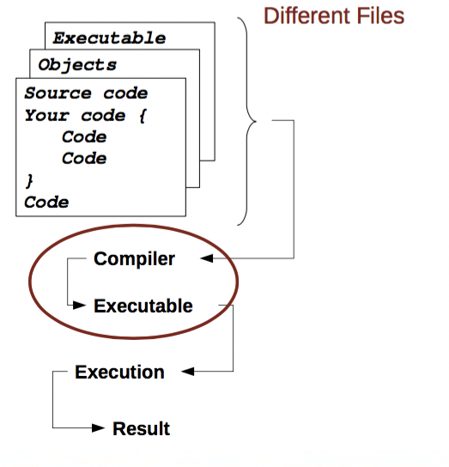
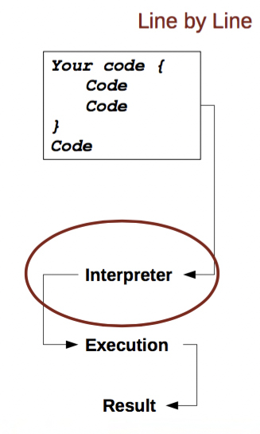
compiled
vs
interpreted
pros
faster execution
can produce a distributable executable standalone file
cons
more complicated to build (many files)
user must administrate memory usage
pros
steep learning curve
takes automatically care of memory usage
allows fast prototyping
cons
usually slower
does not produce standalone programs

Slide 8
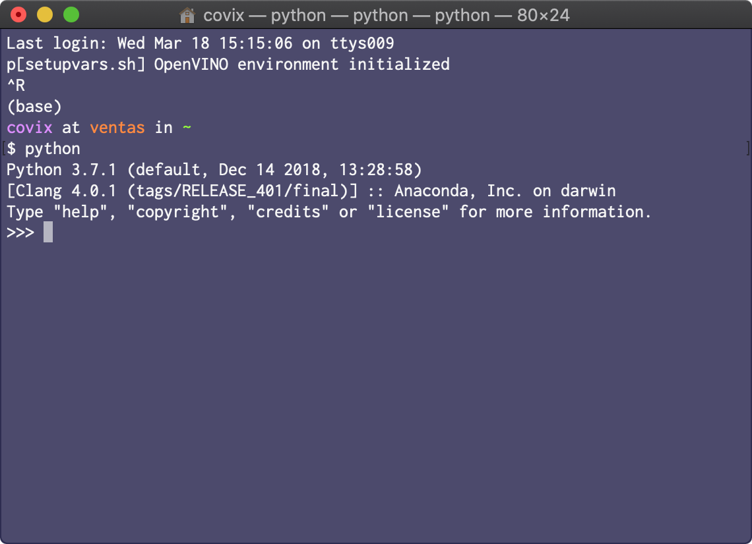
and now?
type python in a shell (or python3)
read–eval–print loop (REPL)
version
caret
distribution
platform

Slide 9
our first Python program …
open a text editor
type print(“Hello World!”)
save the file as hello_world.py
now in the shell type python3 hello_world.py
what happened?
how long compared to other languages?

Slide 10
… and our first Python package
in the shell, type pip3 install ipython
pip3 is a Python package manager
ipython is a better version of the usual Python shell

Slide 11
# environment(s)
the Python standard library is great, but it’s not enough
Python libraries can be easily installed with different package managers (pip, conda, etc.)
projects are usually organized in different environments (with related packages & versions)
let’s run python -m venv /home/wvuser/testenv
python,
create a virtual environment
In this folder
and now, activate it!

Slide 12
time to become pythonist
let’s meet variables, types, and the Zen

Slide 13
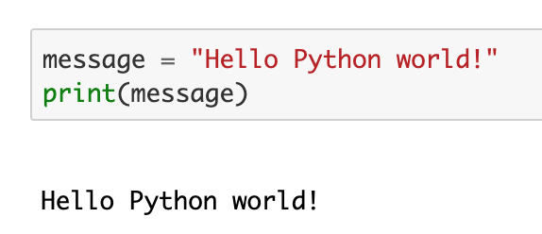
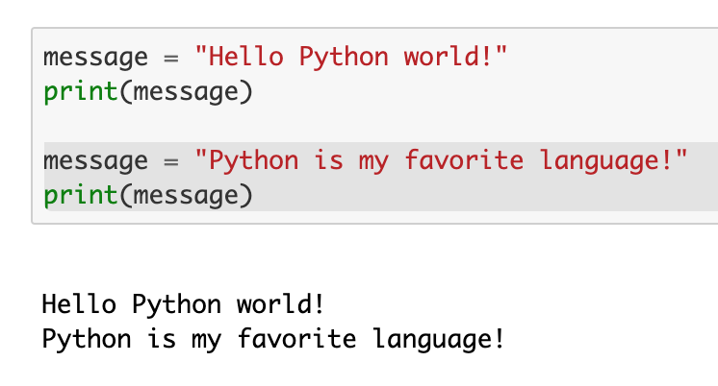
variables
naming rules
variables can only contain letters, numbers, and underscores.
names can start with letters or underscores, but not with numbers.
spaces are not allowed in variable names, use underscores!
you cannot use Python keywords as names
but you can overwrite function or class names!
variable names should be descriptive

Slide 14
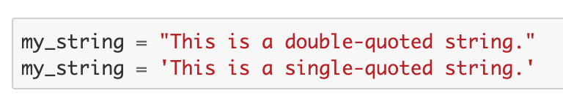
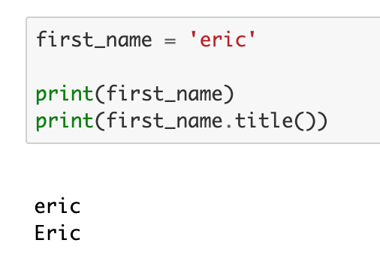
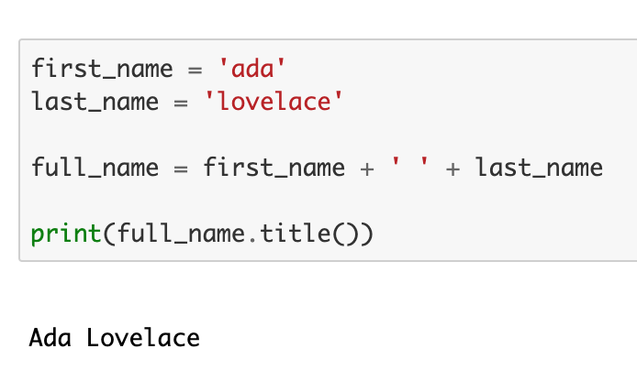
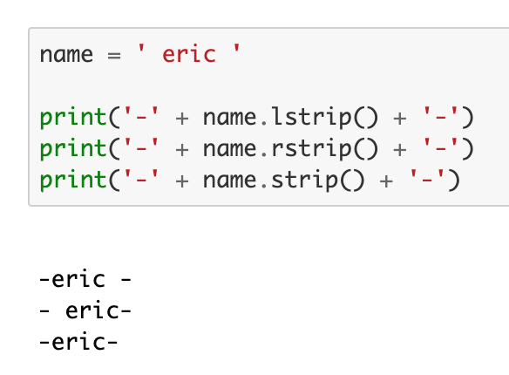
strings
single or double quote!
it’s easy to transform a string!

Slide 15
strings
single or double quote!
it’s easy to transform a string!

Slide 16
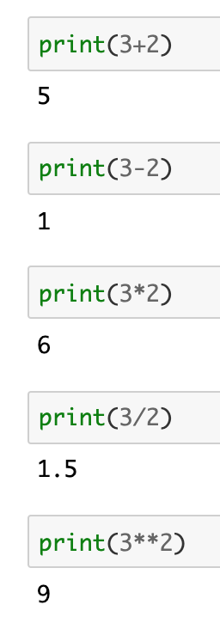
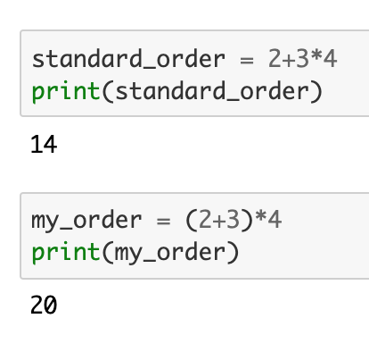
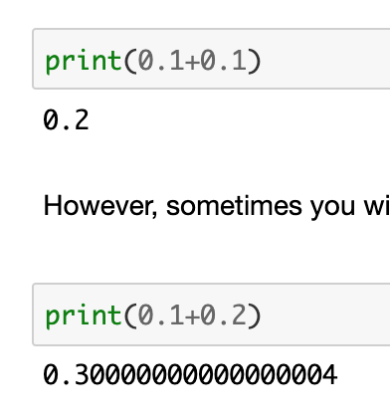
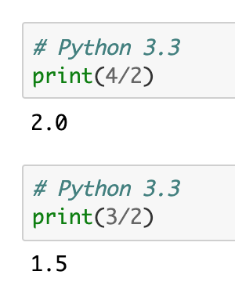
numbers
integers (int)
floating points (float)

Slide 17
numbers
integers (int)
floating points (float)
pretty similar to other languages!
different from other languages?

Slide 18
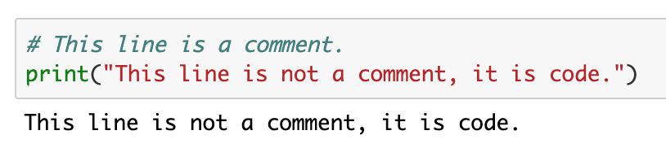
# comments
What makes a good comment?
It is short and to the point, but a complete thought
It explains your thinking for then you return to the code later
It explains your thinking to others who will work with your code
It explains particularly difficult sections of code in detail.
When should you write comments?
When you have to think about code before writing it.
When you are likely to forget later how you approached a problem.
When there is more than one way to solve a problem.
When others are unlikely to anticipate your way of thinking

Slide 19
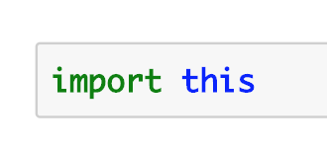
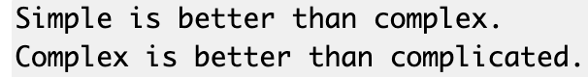


the Zen of Python
aka
Python programmers recognize that good code can actually be beautiful
it’s always better to be clear
keep it simple if you can; if not, do not complicate stuff even more
Always code as if the guy who ends up maintaining your code will be a violent psychopath who knows where you live. Code for readability.
- John F. Woods, 1991
your code cannot be perfect, but it doesn’t mean that you cannot make it work, for now

Slide 20
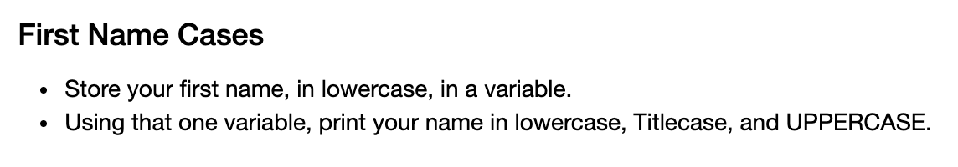
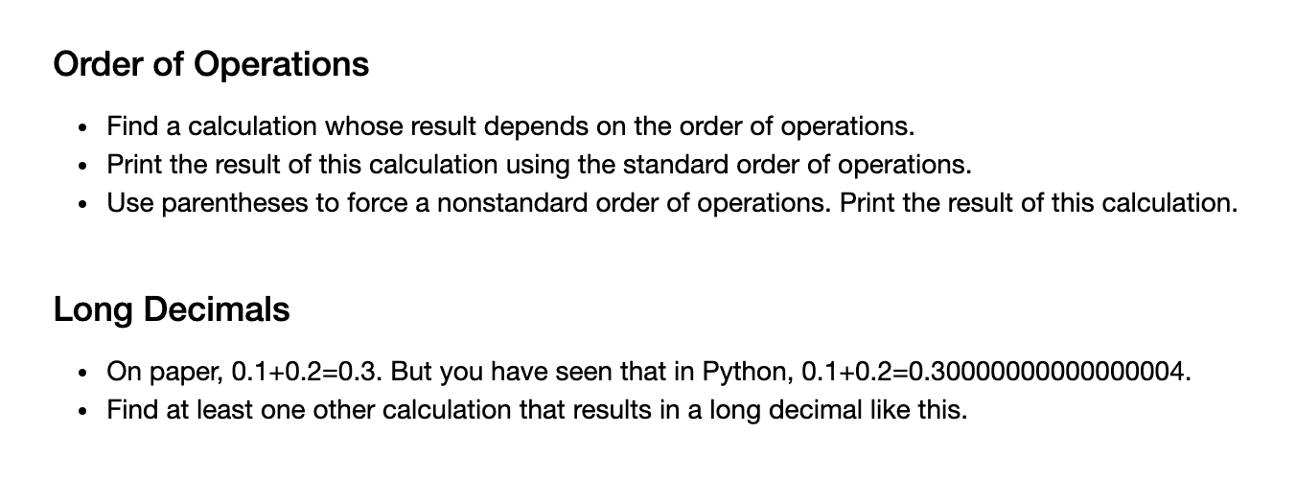
exercises! #1
pro tip: Python error messages are your friends

Slide 21
exercises! #1
+ bonus question:
can you multiply a string by an integer?
pro tip: Python error messages are your friends

Slide 22
a word about types
dynamic typing
it is not required to specify the types of variables/functions
it is automatically inferred by operations
strong typing
once the type has been inferred, it cannot change without explicit cast

Slide 23
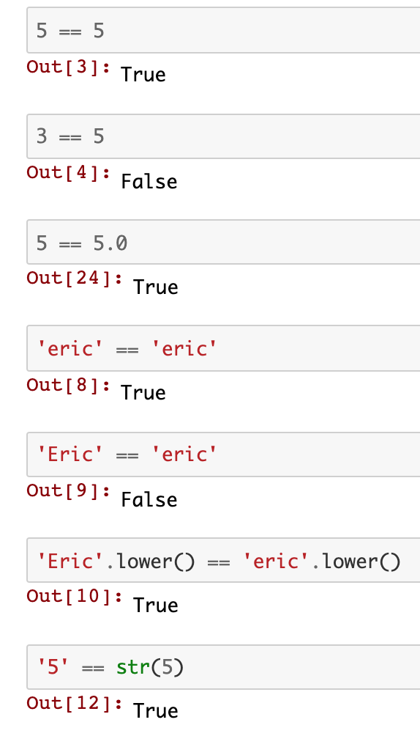
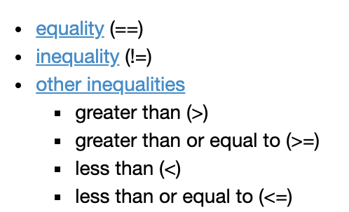
logical tests
wait, did we say anything about the bool type?
no, but bool corresponds to int in Python
in addition there are True and False (as we’ve already seen)
we can also use the next conditional operators to compare variables
remember: equality means having the same value!

Slide 24
logical tests
wait, did we say anything about the bool type?
no, but bool corresponds to int in Python
in addition there are True and False (as we’ve already seen)
we can also use the next conditional operators to compare variables
remember: equality means having the same value!

Slide 25
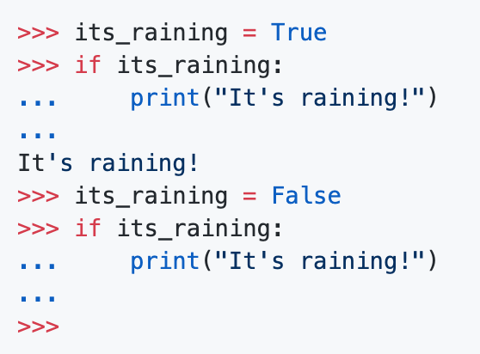
the if, the else and the.. offside
an if statement tests for a condition, and then responds to that condition.
if the condition is true, then whatever action is listed next gets carried out.
you can test for multiple conditions at the same time, and respond appropriately to each condition.
what about this?
the offside rule is used to decide what’s inside the block
it applies to all blocks!
conditionals, loops and functions!

Slide 26
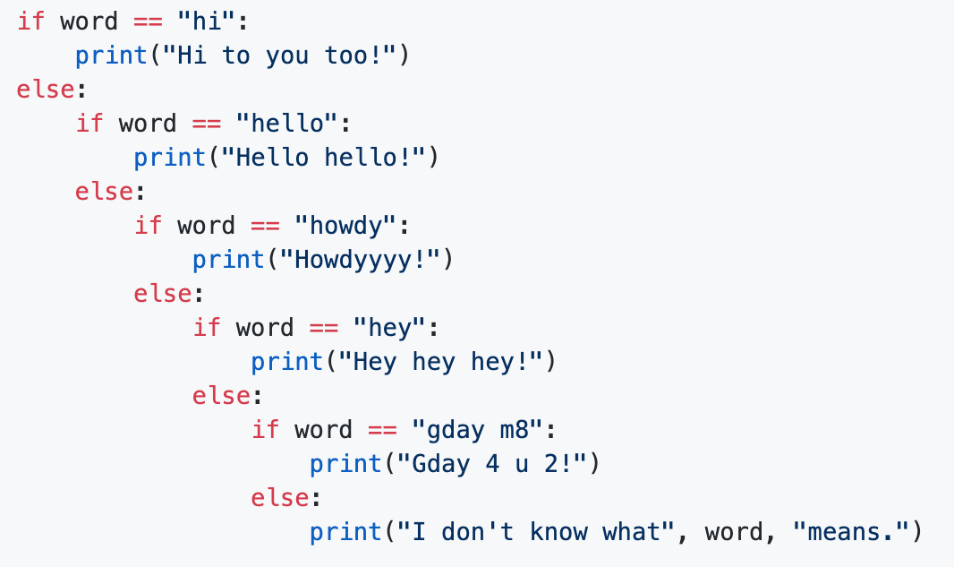
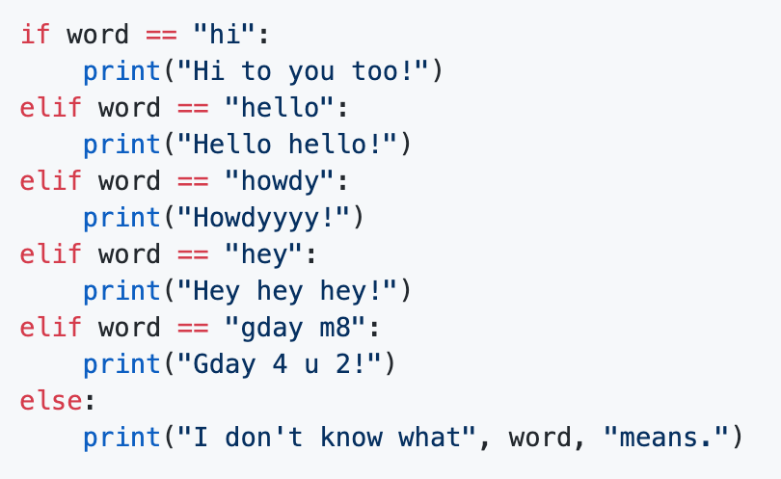
the if, the else and the.. offside
an if statement tests for a condition, and then responds to that condition.
if the condition is true, then whatever action is listed next gets carried out.
you can test for multiple conditions at the same time, and respond appropriately to each condition.
what about this?
the offside rule is used to decide what’s inside the block
it applies to all blocks!
conditionals, loops and functions!
never forget about elif!

Slide 27
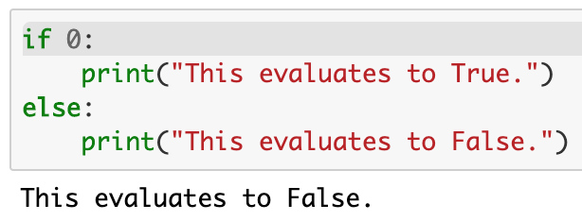
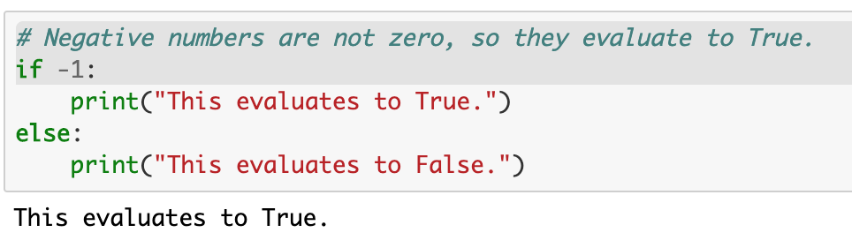
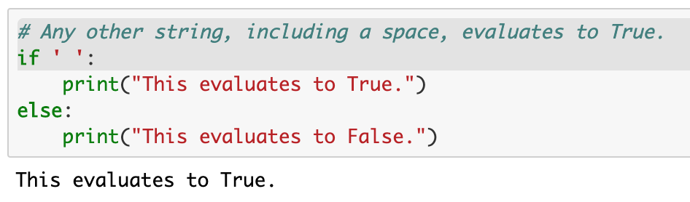
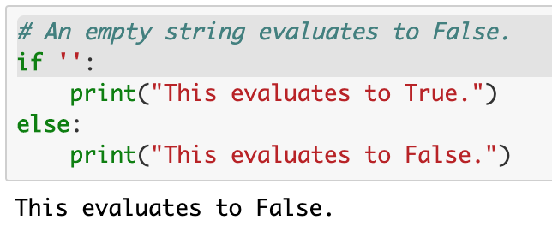
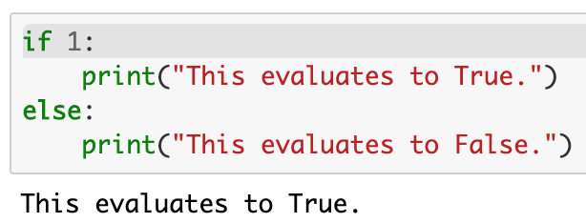
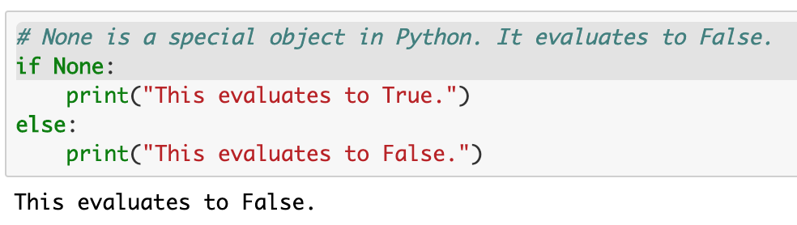
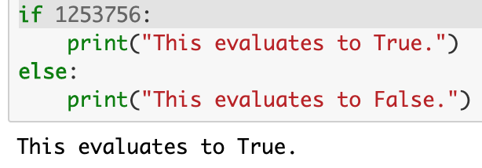
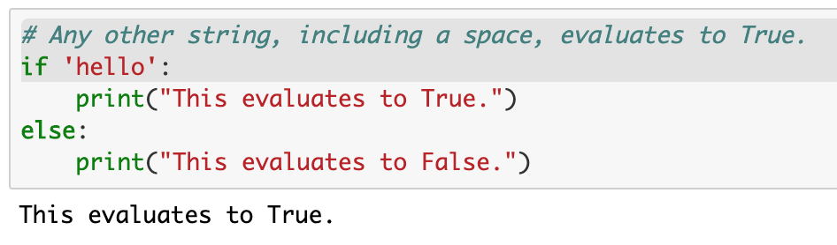
but, what is True?
1
3
6
2
4
7
3
5

Slide 28
but, what is True?
1
3
6
2
4
7
3
5

Slide 29
built-in data structures
iterables: lists, tuples, sets, dictionaries

Slide 30
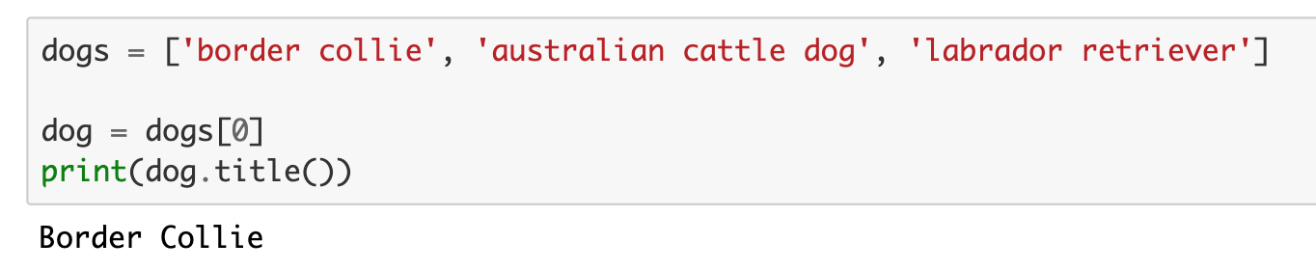
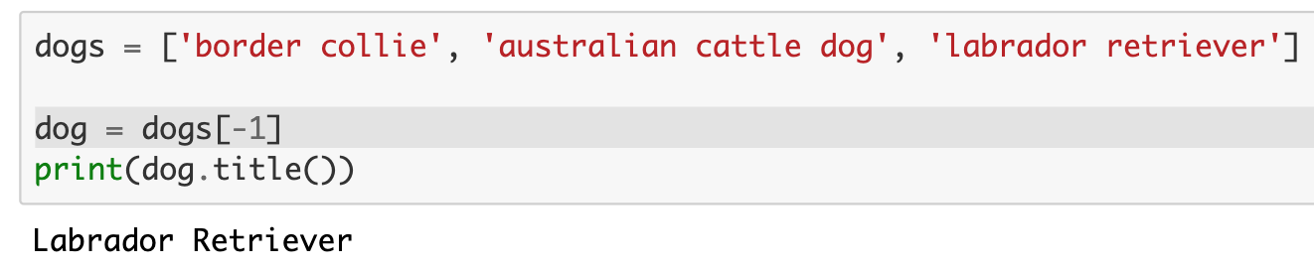
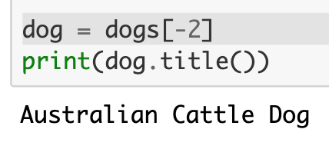
[lists]
a list is a collection of items, that is stored in a variable.
the items should be related in some way
but there are no restrictions on what can be stored in a list.
since lists are collection of objects, it is good practice to give them a plural name.
if each item in your list is a car, call the list 'cars'.

Slide 31
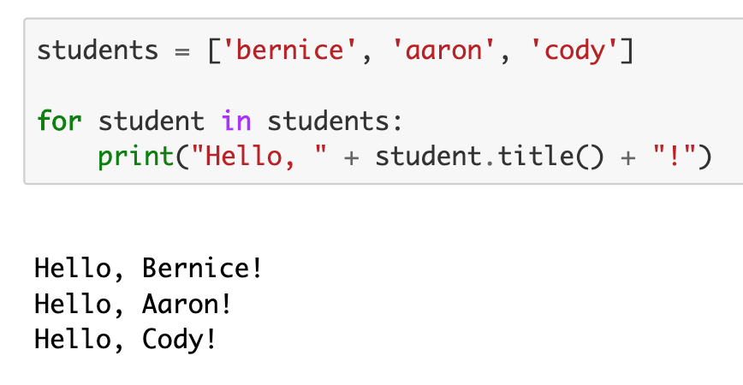
[lists]
square brackets define lists
a list is a collection of items, that is stored in a variable.
the items should be related in some way
but there are no restrictions on what can be stored in a list.
since lists are collection of objects, it is good practice to give them a plural name.
if each item in your list is a car, call the list 'cars'.
for is a keyword for the for (-each) loop
student is a temporary variable
the nested block is created with the offside rule

Slide 32
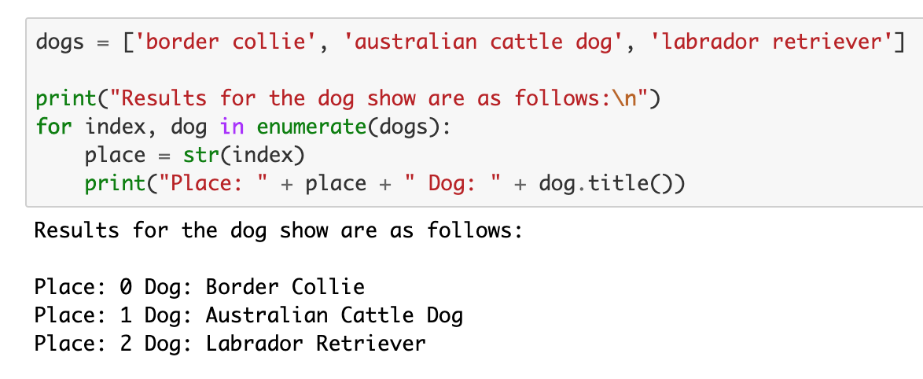
enumerate a list
what if you want to print the index and the value at that index in a list?
just keep a counter variable i and use value[i], right?
or maybe use the function enumerate!

Slide 33
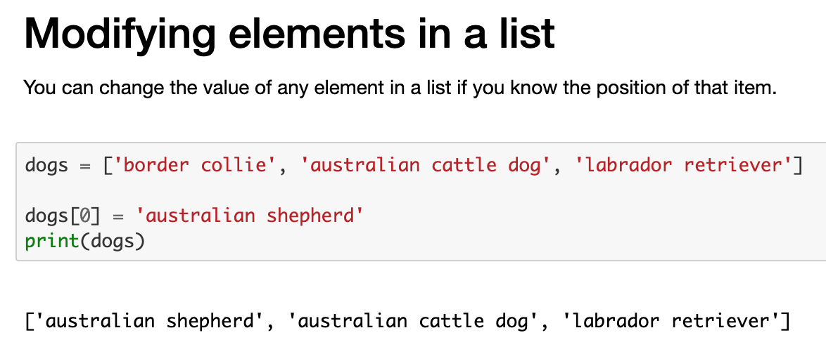
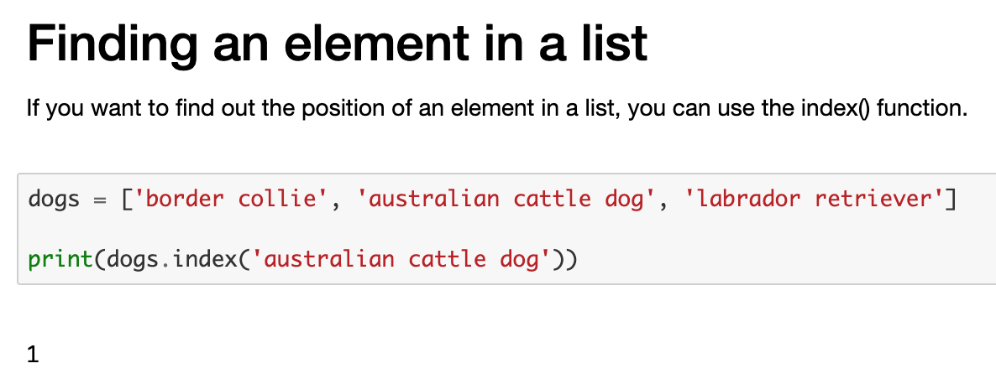
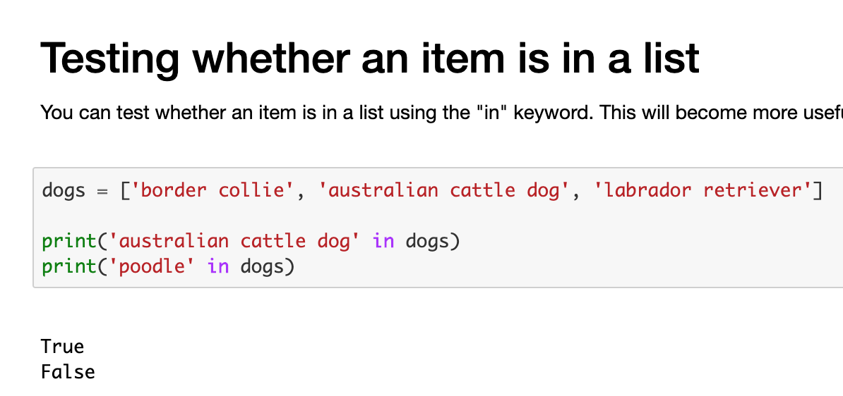
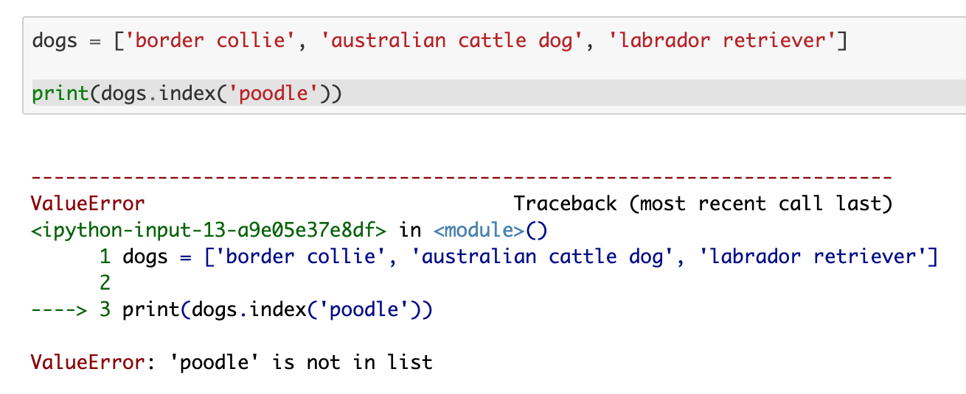
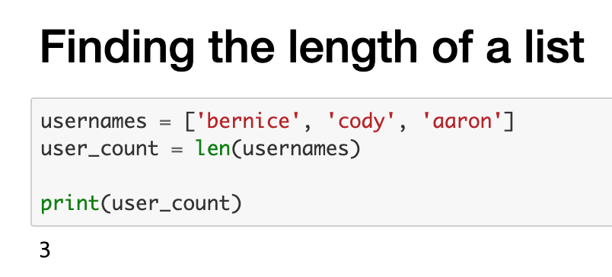
common list operation

Slide 34
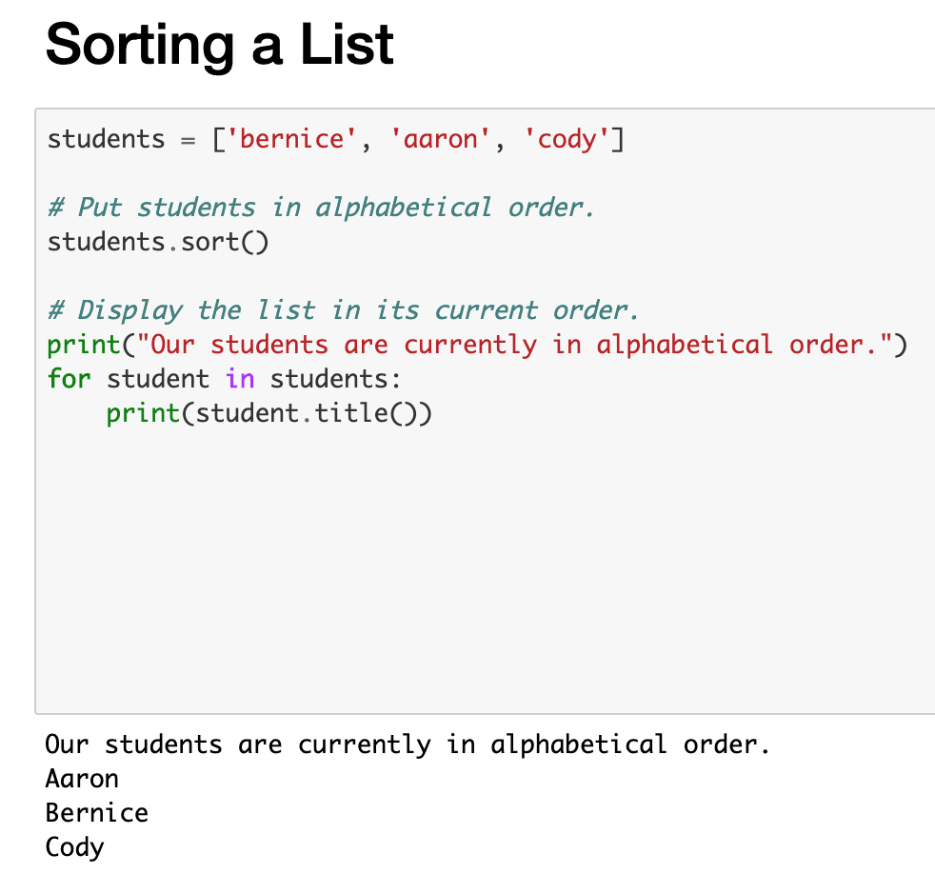
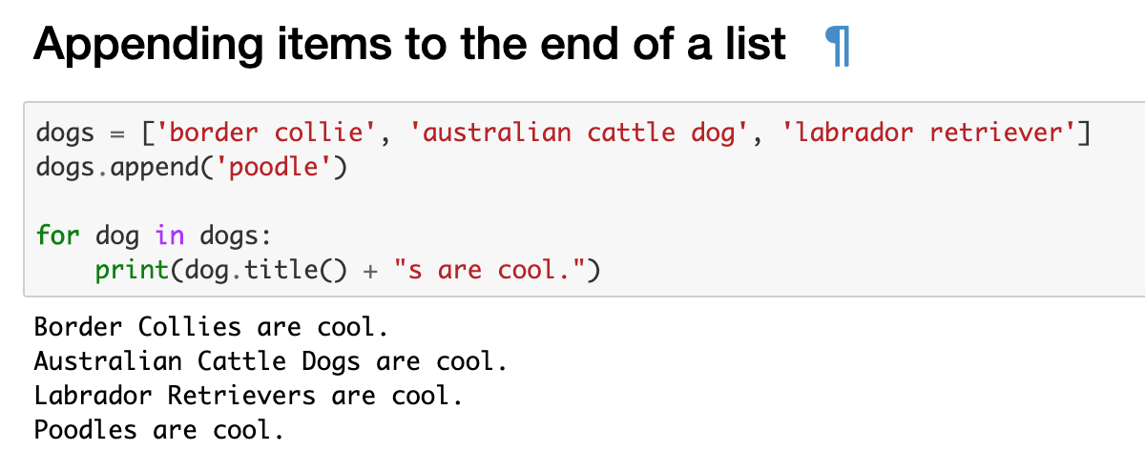
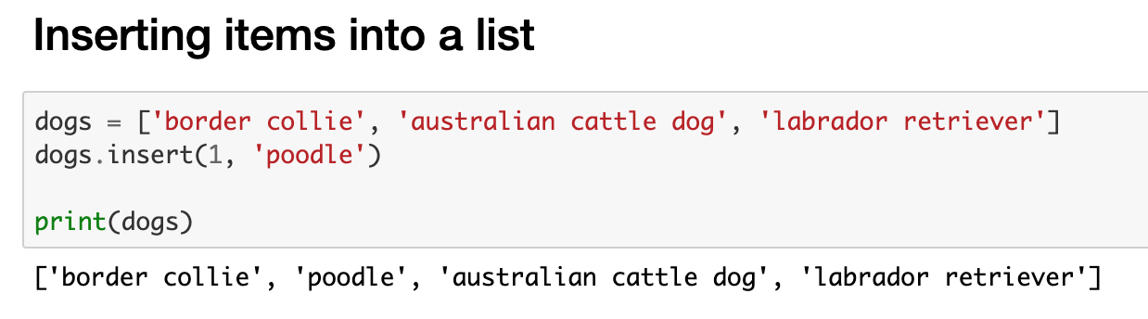
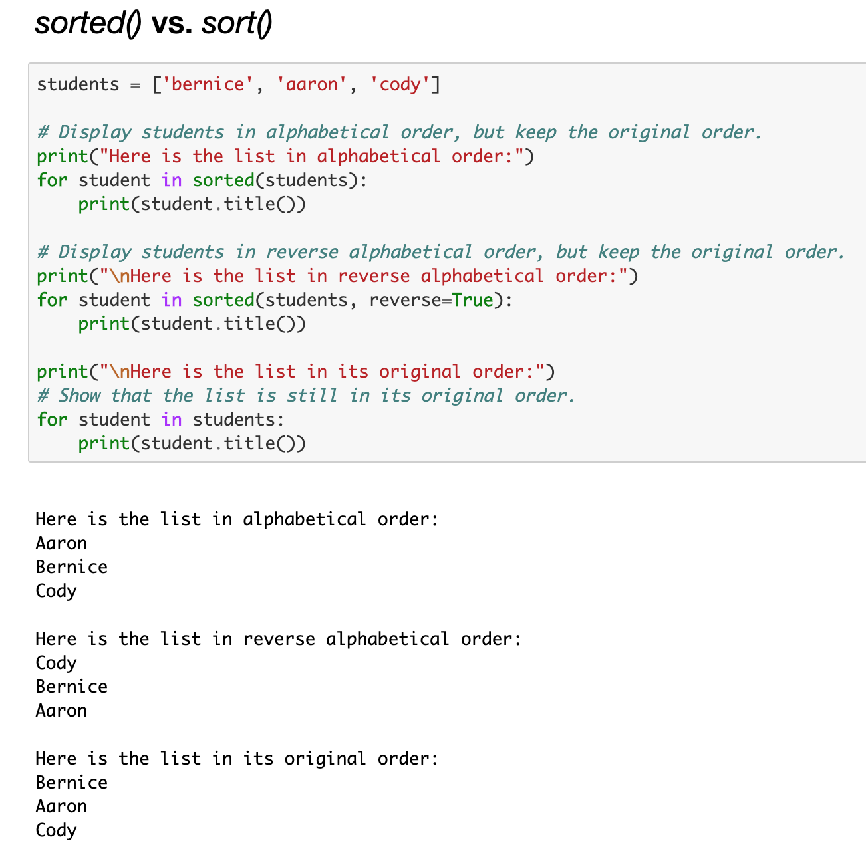
more common list operation
sorted doesn’t sort the list in-place!

Slide 35
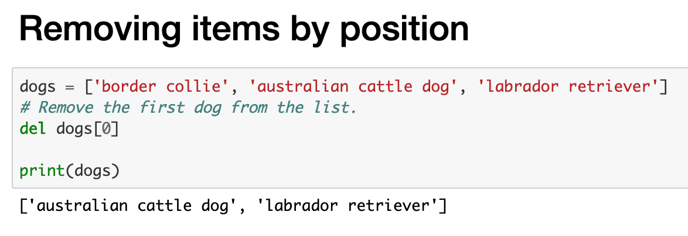
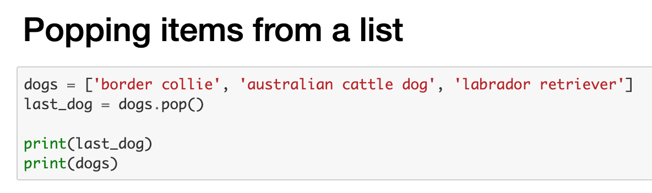
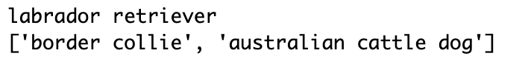
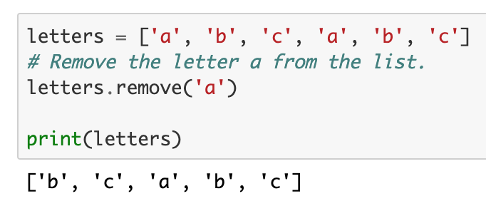
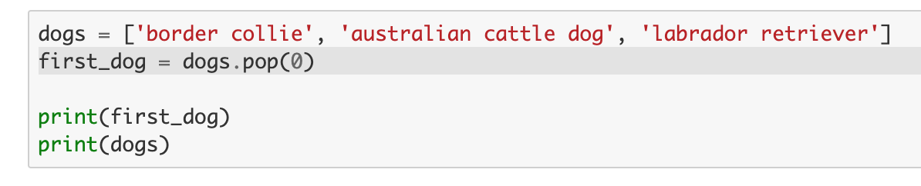

more more common list operation

Slide 36


exercises! #2
hey! some of you may want to use Python functions: you can if you’re brave enough!

Slide 37



slicing a list[:]
a list is a collection of items and we should be able to get any subset
we can use the notation list[start_index:end_index] to select all the elements from index start_index (included) to end_index (excluded)

Slide 38

deep vs shallow copy
usernames is not really a list: under the hood is a pointer to a list in memory
if we want to make a deep copy of the list, we can slice all the elements out of it
usernames
copied
usernames
usernames
copied
usernames

Slide 39




[numerical lists]
aka do not expect anything special, apart from range, min, max and sum
mini exercise:
can you type just range(11)?
mini exercise:
can you type just range(21,2)?
mini exercise:
what if you don’t use list?

Slide 40



[list comprehensions]
it allow us to collapse the first three lines of code into one line:

Slide 41


exercises! #3

Slide 42







“strings” + “(again?)”
we can use them as lists, and we can convert them to lists

Slide 43




“strings” + “(again?)” + “(again?)”

Slide 44

exercises! #4

Slide 45

Python for genetics!
http://rosalind.info/problems/list-view/

Slide 46

while loop:

Slide 47

while loop: more

Slide 48

{dictionaries: ‘what are they’}
dictionaries are a way to store information that is connected in some way.
dictionaries store information in key-value pairs,
any piece of information is connected to at least one other piece of information.
dictionaries do not store their information in any particular order

Slide 49


{dictionaries: ‘how to iterate’}

Slide 50



{more: dictionaries}

Slide 51



looping through dictionaries
accessing to key-value pairs
accessing to values
accessing to keys

Slide 52

exercises! #5

Slide 53

functions()
functions are a set of actions that we group together and give a name to.
you have already used a number of functions (methods) from the core Python language, such as string.title() and list.sort().
we can define our own functions, which allows us to "teach" Python new behaviour.

Slide 54

functions(more)
functions are a set of actions that we group together and give a name to.
you have already used a number of functions (methods) from the core Python language, such as string.title() and list.sort().
we can define our own functions, which allows us to "teach" Python new behaviour.
by default functions return None, we can change this behaviour using the return keyword

Slide 55


function(arguments)
default arguments
keyword arguments

Slide 56


*arguments of variable length
*args lets you accept a variable number of arguments
you can consider *args as a list

Slide 57


**keyword arguments of variable length
you can consider **kwargs as a dictionary
**kwargs lets you accept a variable number of keyword arguments

Slide 58

class:
classes are a way of combining information and behaviour.
let's consider what you'd need to do if you were creating a rocket ship in a game:
you'd want to track are the x and y coordinates of the rocket
the objective is not to learn about oop design’s principle, but to get used to Python syntax for classes!
class constructor
instance method
self is the keyword for the instance itself

Slide 59

class(inheritance):
from module math import function sqrt
the class Rocket is our base class
we can create other classes that are based on it
for example, we can create a reusable rocket, or a Shuttle
this child class will have access to the move_rocket and get_distance functions
remember: a Shuttle can quack like a Rocket

Slide 60

from module import classes
we can save the Rocket and the Shuttle classes in a module (python script) called rocket.py
now we can import those classes from the rocket module and reuse them
wait, modules?
modules are nothing more than python scripts containing reusable code (classes, functions, etc.)
modules are organized in packages

Slide 61


open(files)
Mode | Short for | Meaning
r | read | Read from an existing file.
w | write | Write to a file. If the file exists, its old content is removed.
a | append | Write to the end of a file, and keep the old content.

Slide 62
ip geo location
we need the geoip2==2.9.0 package (pip install geoip2==2.9.0) and the GeoLite2 database
load the database
query the database
extract the interesting fields

Slide 63
ip geo location
we need the geoip2==2.9.0 package (pip install geoip2==2.9.0) and the GeoLite2 database
load the database
reader = geoip2.database.Reader("./GeoLite2-City_20191001/GeoLite2-City.mmdb")
query the database
extract the interesting fields

Slide 64
ip geo location
we need the geoip2==2.9.0 package (pip install geoip2==2.9.0) and the GeoLite2 database
load the database
reader = geoip2.database.Reader("./GeoLite2-City_20191001/GeoLite2-City.mmdb")
query the database
response = reader.city(ip)
extract the interesting fields

Slide 65
ip geo location
we need the geoip2==2.9.0 package (pip install geoip2==2.9.0) and the GeoLite2 database
load the database
reader = geoip2.database.Reader("./GeoLite2-City_20191001/GeoLite2-City.mmdb")
query the database
response = reader.city(ip)
extract the interesting fields
city = response.city.name
country = response.country.name
longitude = response.location.longitude
lat = response.location.latitude

Slide 66
thanks for the attention
import antigravity

